Slide 2
Carbonyl Condensation Reactions
Crossed Aldol Reactions
Crossed aldols are synthetically useful in two different situations:
[1] When only one carbonyl component has α hydrogens—such cases often lead to the formation of only one product.

Slide 3
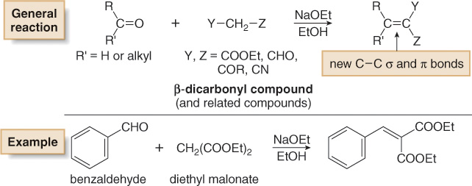
Carbonyl Condensation Reactions
Crossed Aldol Reactions
[2] When one carbonyl component has especially acidic α hydrogens, these hydrogens are more readily removed than the other α H atoms. As a result, the β-dicarbonyl compound always becomes the enolate component of the aldol reaction.

